Slide 1
Yelp Reviews – A Study
A CS223 Class Project
Team Members : Aishwarya Soni, Praveen Subramaniyam, Shivika Sodhi, Prathiba Nagarajan

Slide 2
Introduction
The Need To Process Text
An Introduction to Yelp
Focus of this Project
Overview of the Project Flow

Slide 3
The Need to Process Text
Sentiment Analysis
Spam Filtering
Plagiarism Detection
Smarter Search
Simple Keyword Frequency Analysis
Phrase Extraction

Slide 4
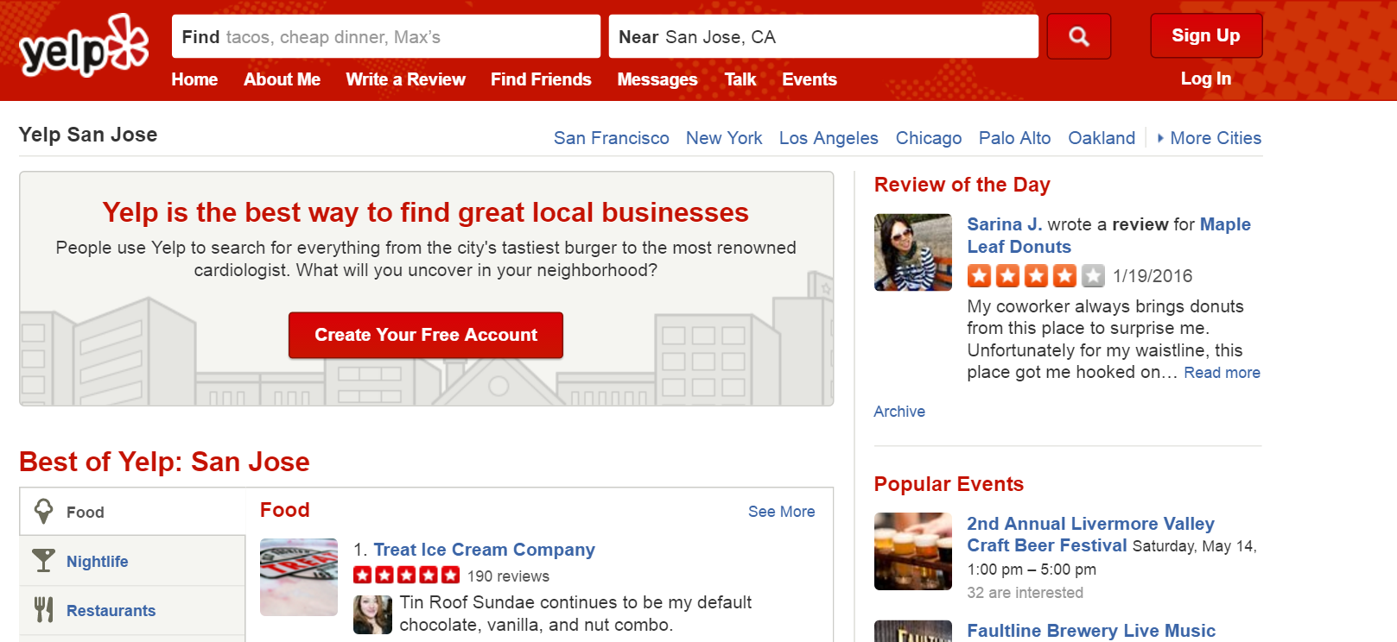
What is Yelp
Yelp is an American MNC , founded in 2004, headquartered in San Francisco, California. It develops, hosts and markets Yelp.com, which crowd-sourced reviews about local businesses, as well as the online reservation service SeatMe and online food-delivery service Eat24 [1].

Slide 5
Focus of this project
Yelp introduced a “Dataset Challenge” (https://www.yelp.com/dataset_challenge/) to gain interesting insights into the data, with challenges such as finding cultural and seasonal trends, infer categories, natural language processing (NLP) etc.
We chose the challenge of NLP, which involved the correlation of reviews’ text and ratings to find positive reviews and negative reviews.

Slide 6
Overview of the Project Flow
Sub Problem One
Sub Problem Two
Removed stopwords using the NLTK package from the user reviews.
Applied Naïve Bayes using NLTK , dividing the text into positive and negative reviews based on “stars” ratings.
Sub Problem Three
Compare the results derived from the approached mentioned above.
Extracted the user reviews (“text”) and ratings (“stars”) from dataset_review.json using the business_id extracted.
Preprocess data. Extract the Business ID data related to the ‘food’ category from dataset_business.json (65 MB).
Clean data and write to CSV files.
Applied VADER using NLTK to achieve the same
Plot the results from VADER using matplotlib to observe the working and accuracy of the classification.
Plot the results from Naïve Bayes classifier.

Slide 7
Processing of Data
We received five sets of data files containing information of business, users, check-in, reviews, users and tips.
General Format:
{ 'type': 'review', 'business_id': (encrypted business id), 'user_id': (encrypted user id), 'stars': (star ratings), 'text': (review text), 'date': (date, formatted like '2012-03-14'), 'votes': {(vote type): (count)} }
We extracted the review text, the star ratings and the business ID and transferred it to a CSV file, for optimization.

Slide 8
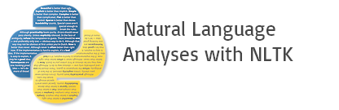
Natural Language Toolkit (NLTK)
What is NLTK
A tool consisting of a collection of libraries and programs in python that allows for customization and optimization of NLP processes i.e., working with human language data.
It is an open source library and can be downloaded from http://nltk.org/ (or download from Canopy’s Package Manager )
Features of NLTK
Text Classification
Sentence Tokenization
Word Tokenization
Speech Tagging
Clustering

Slide 9
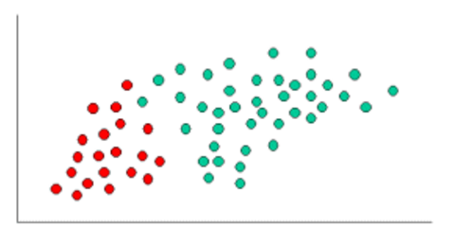
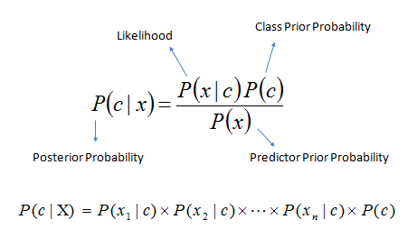
Naïve Bayes Classifier
The objects can be classified as either Green or Red.
Our task is to classify new cases as they arrive, i.e., decide to which class label they belong, based on the currently existing objects.
Formula for Naïve Bayes

Slide 10

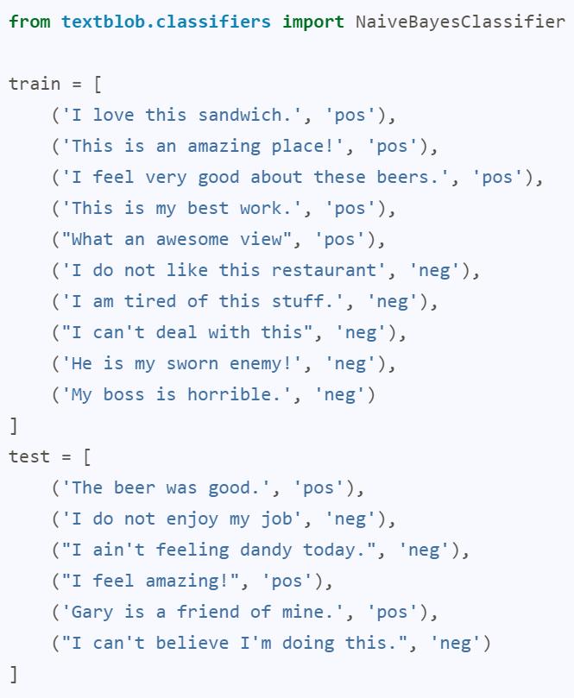
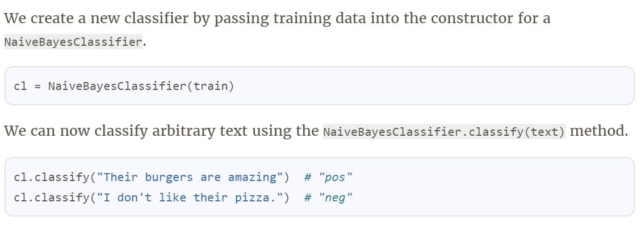
Example (Naïve Bayes using TextBlob)
A Tweet Sentiment Analyzer (Simple classification)[5]

Slide 11
NLTK sentiment analyzer using VADER
VADER (Valence Aware Dictionary and sEntiment Reasoner) is a lexicon and rule-based sentiment analysis tool that is specifically attuned to sentiments expressed in social media [2][3]
Lexicon based unsupervised learning uses a sentiment dictionary
The VADER lexicon is sensitive to the social media sentiment in terms of polarity (positive/negative) and intensity.
It contains over 7500 lexical features with intensity varying from -4 (extremely negative) to +4 (extremely positive)
Example : “Okay” : 0.9, “Good” : 1.9, “Horrible” : -2.5, “☹” : -2.2

Slide 12
NLTK sentiment analyzer using VADER
To produce a score for a particular sentence:
Removes stop words
Removes multiple !,? and other such punctuation
Checks for negation (don’t, aren’t etc.) and boosters (incredibly, extremely etc.).
Check for contrastive conjunction (but).
Examples :
The book was kind of good. {'neg': 0.0, 'neu': 0.657, 'pos': 0.343}
The plot was good, but the characters are uncompelling and the dialog is not great. {'neg': 0.327, 'neu': 0.579, 'pos': 0.094}
A really bad, horrible book. {'neg': 0.791, 'neu': 0.209, 'pos': 0.0}

Slide 13
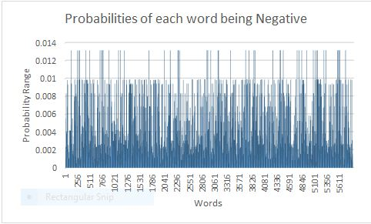
Results – Naïve Bayes Classifier
Naïve Bayes algorithm gave an accuracy of 0.76511
Training data size : 1658
Testing data size : 711
False Positive : 167
True Negative : 544
Accuracy : 0.76511955

Slide 14
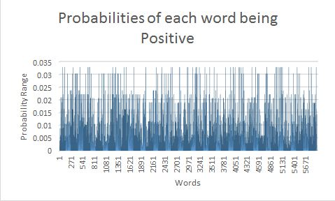
Results – Naïve Bayes Classifier

Slide 15
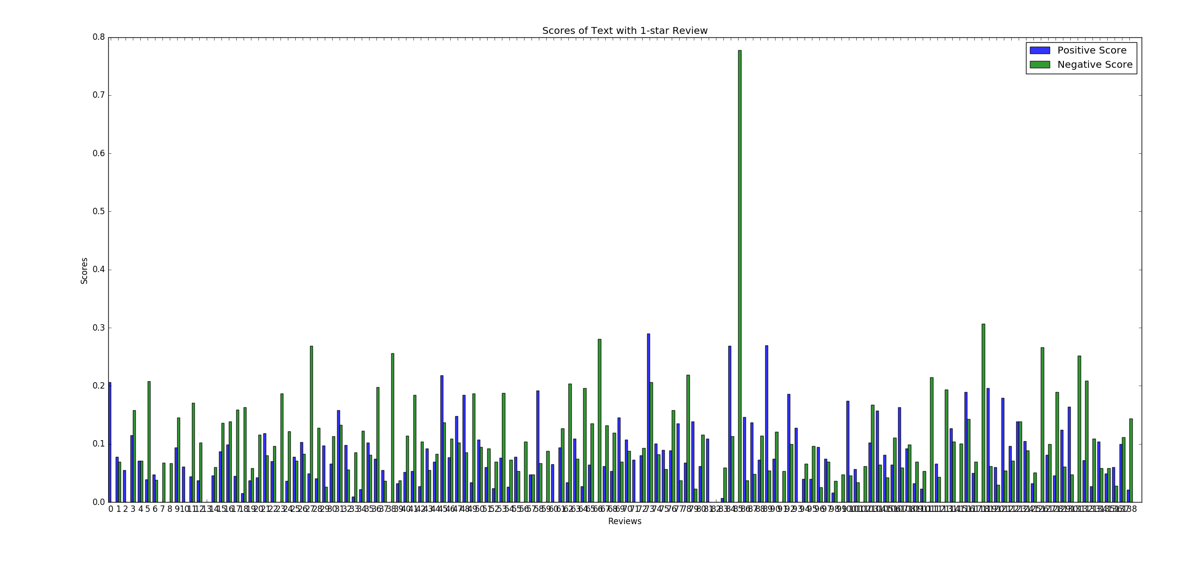
Results – Sentiment analysis using VADER
Percentage of positive values > negative values for 1-star Reviews: 39.17 %

Slide 16
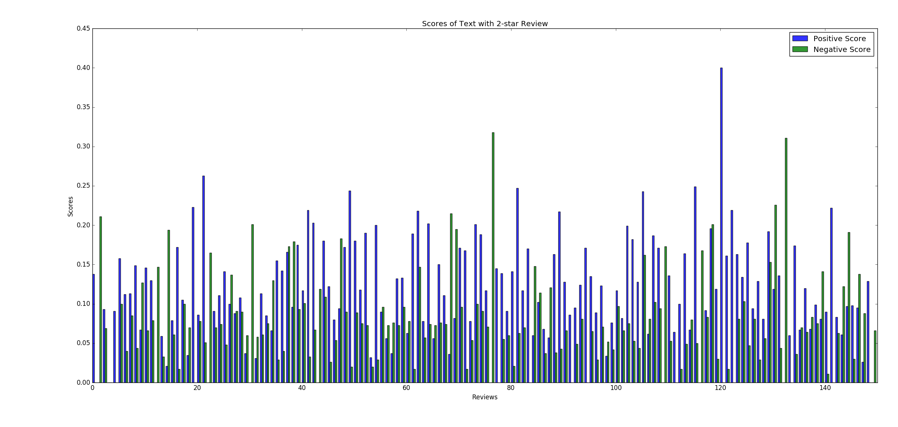
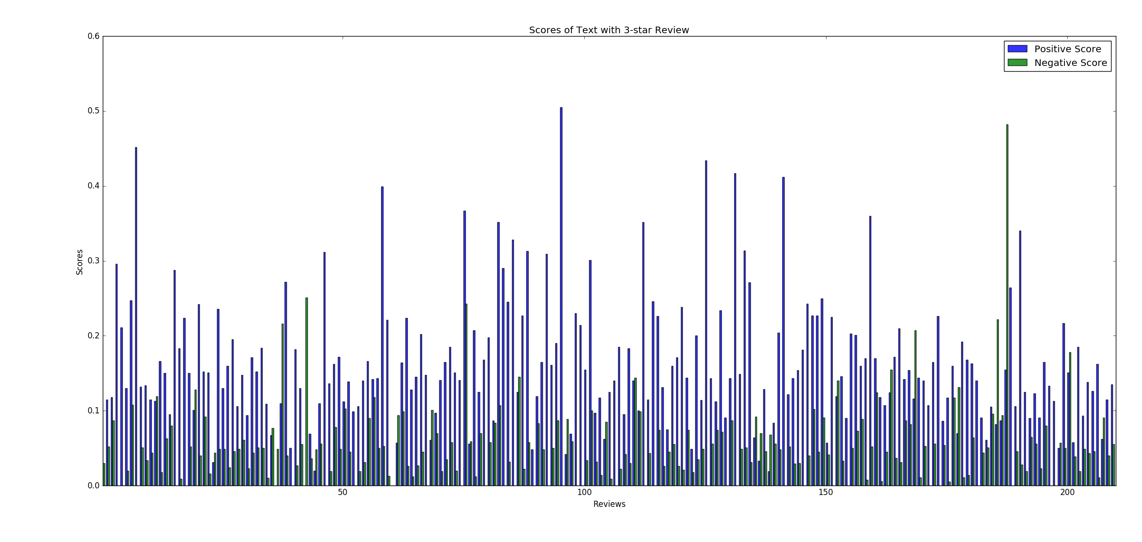
Results – Sentiment analysis using VADER
Percentage of positive values > negative values for 2-star Reviews: 66.57 %
Percentage of positive values > negative values for 3-star Reviews: 87.57 %

Slide 17
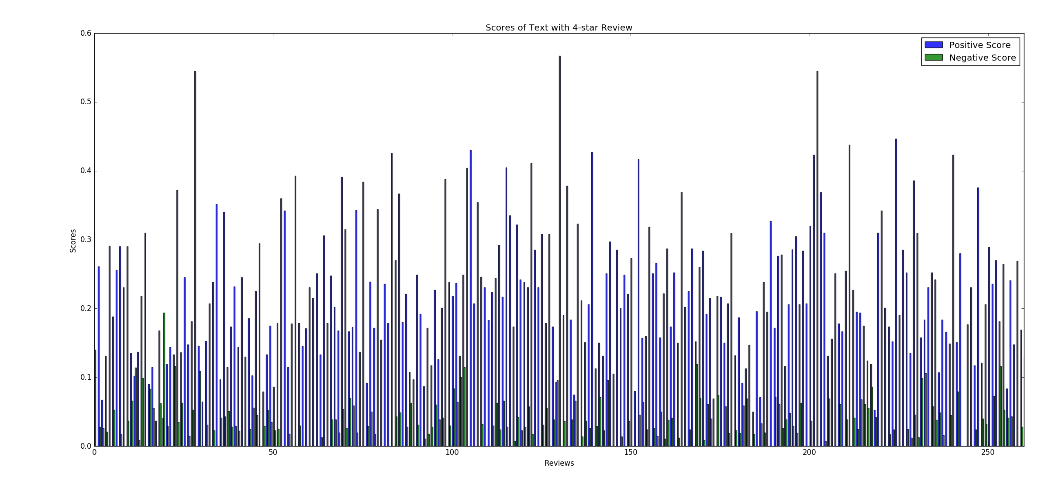
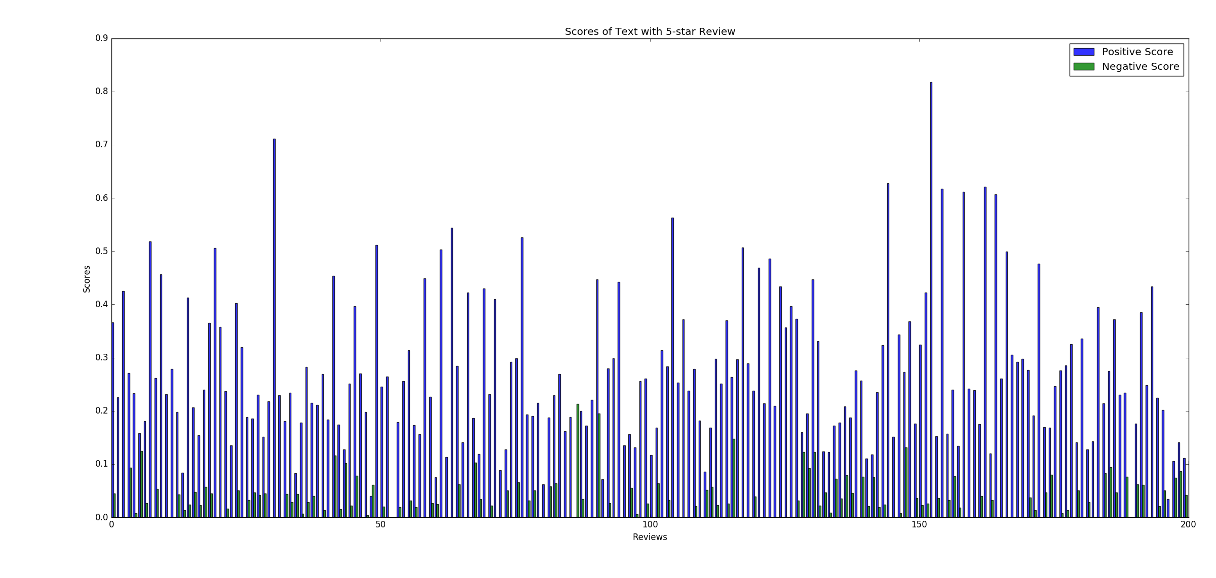
Results – Sentiment analysis using VADER
Percentage of positive values > negative values for 4-star Reviews: 96.15 %
Percentage of positive values > negative values for 5-star Reviews: 97.05 %

Slide 18
Future Work
Using other models such as Support Vector and Maximum Entropy Classifiers.
Using word n-grams (sequence of n- consecutive words) for the feature space.

Slide 19
References
https://en.wikipedia.org/wiki/Yelp
https://github.com/cjhutto/vaderSentiment
Hutto, C.J. & Gilbert, E.E. (2014). VADER: A Parsimonious Rule-based Model for Sentiment Analysis of Social Media Text. Eighth International Conference on Weblogs and Social Media (ICWSM-14). Ann Arbor, MI, June 2014.
http://www.statsoft.com/textbook/naive-bayes-classifier
http://stevenloria.com/how-to-build-a-text-classification-system-with-python-and-textblob/

Slide 20
Code repository: https://github.com/CS223-YelpReview/Yelp-NLP
Thank You

